Slide 1
CSC302 Product Demo
Xreamier
Daniel Chan
raymondGao
patrick_gronowski
Nick Nadeau
Jonathan Pelastine
Matthew Veltri

Slide 2
Goal

Slide 3
Goal
Ticket management system
Notes:
We wanted to create a system that allowed for the management of tickets with very high fidelity.

Slide 4
Goal
Ticket management system
Focus on backend
Notes:
As a result we focused mainly on the backend

Slide 5
Goal
Ticket management system
Focus on backend
Easy to Use
Notes:
And we wanted the APIs to be easy to understand and use

Slide 6
Goal
Ticket management system
Focus on backend
Easy to Use
Versatile
Notes:
As well as versatile

Slide 7
Learning Goals
Team Member | Desired Skill
Matthew | Django/Flask
Patrick | React/Flask
Nick | Flask
Jonathan | React/Flask
Daniel | Docker
Ray | ORM
Notes:
Here are our learning goals that we described in the first deliverable. In the beginning we thought It would be cool for everyone to have their own individualized learning goals. But we realized very quickly that it was difficult to coordinate between so many people learning different new things. We eventually boiled our goals down to just React, Docker and ORM.

Slide 8
Use of Docker and ORM
ORM allows us to create powerful and easy to use sql queries as object calls.
Docker gives us containerization, allows us to isolate our microservices. Also makes deployment easier.
Notes:
We decided to focus mainly on Docker and ORM.

Slide 10
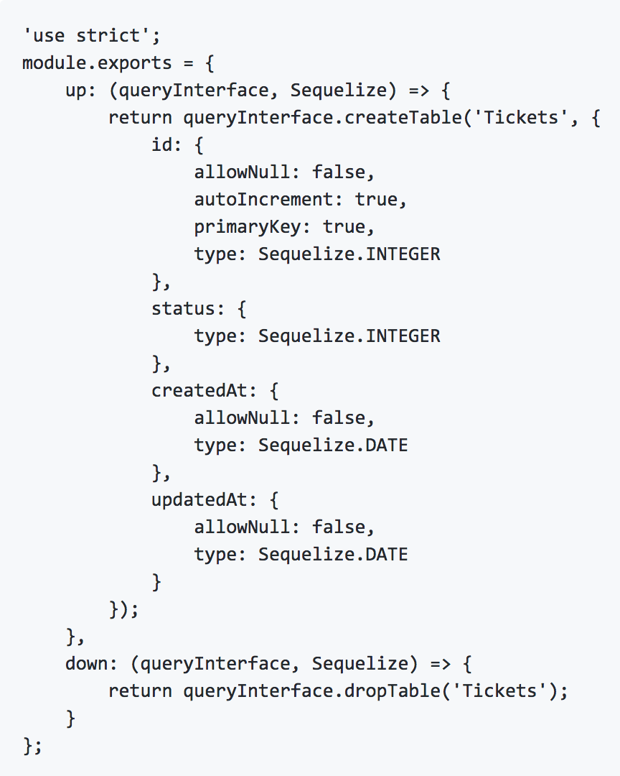

Slide 11
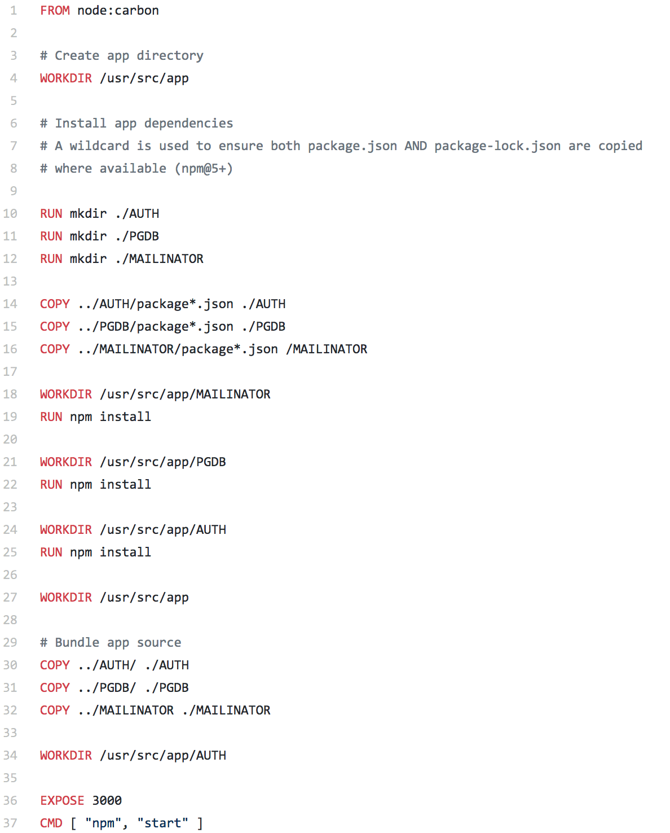

Slide 12
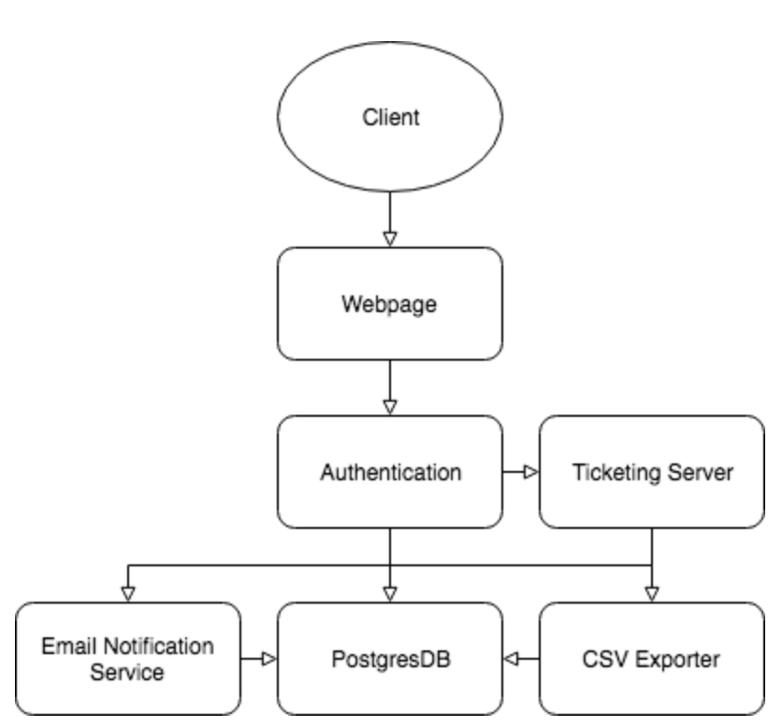
How its Made (Architecture)
After doing our analysis of the problem, we split our problem up into microservices.

Slide 13
Architecture

Slide 14
Project Strategy & Collaboration
Split into sub-teams, a buddy system

Slide 15
Project Strategy & Collaboration
Split into sub-teams, a buddy system
Code reviews & pull requests.

Slide 16
Project Strategy & Collaboration
Split into sub-teams, a buddy system
Code reviews & pull requests.
Milestones

Slide 17
Project Strategy & Collaboration
Split into sub-teams, a buddy system
Code reviews & pull requests.
Milestones
Discord & Github Integration

Slide 18
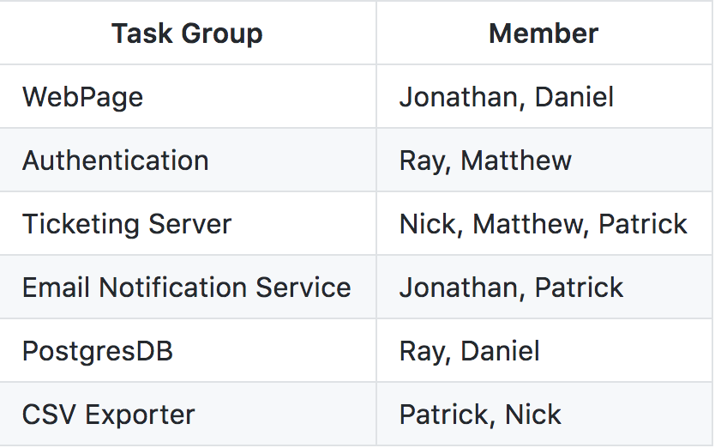
Buddy System
Split our resources among the 6 microservices

Slide 19
Buddy System
Broke down very quickly

Slide 20
Buddy System
Broke down very quickly
Our initial assumptions were wrong

Slide 21
Buddy System Epilogue
Kanban

Slide 22
Buddy System Epilogue
Kanban
Load balancing

Slide 23
Buddy System Epilogue
Kanban
Load balancing
Better suited for Academics

Slide 24
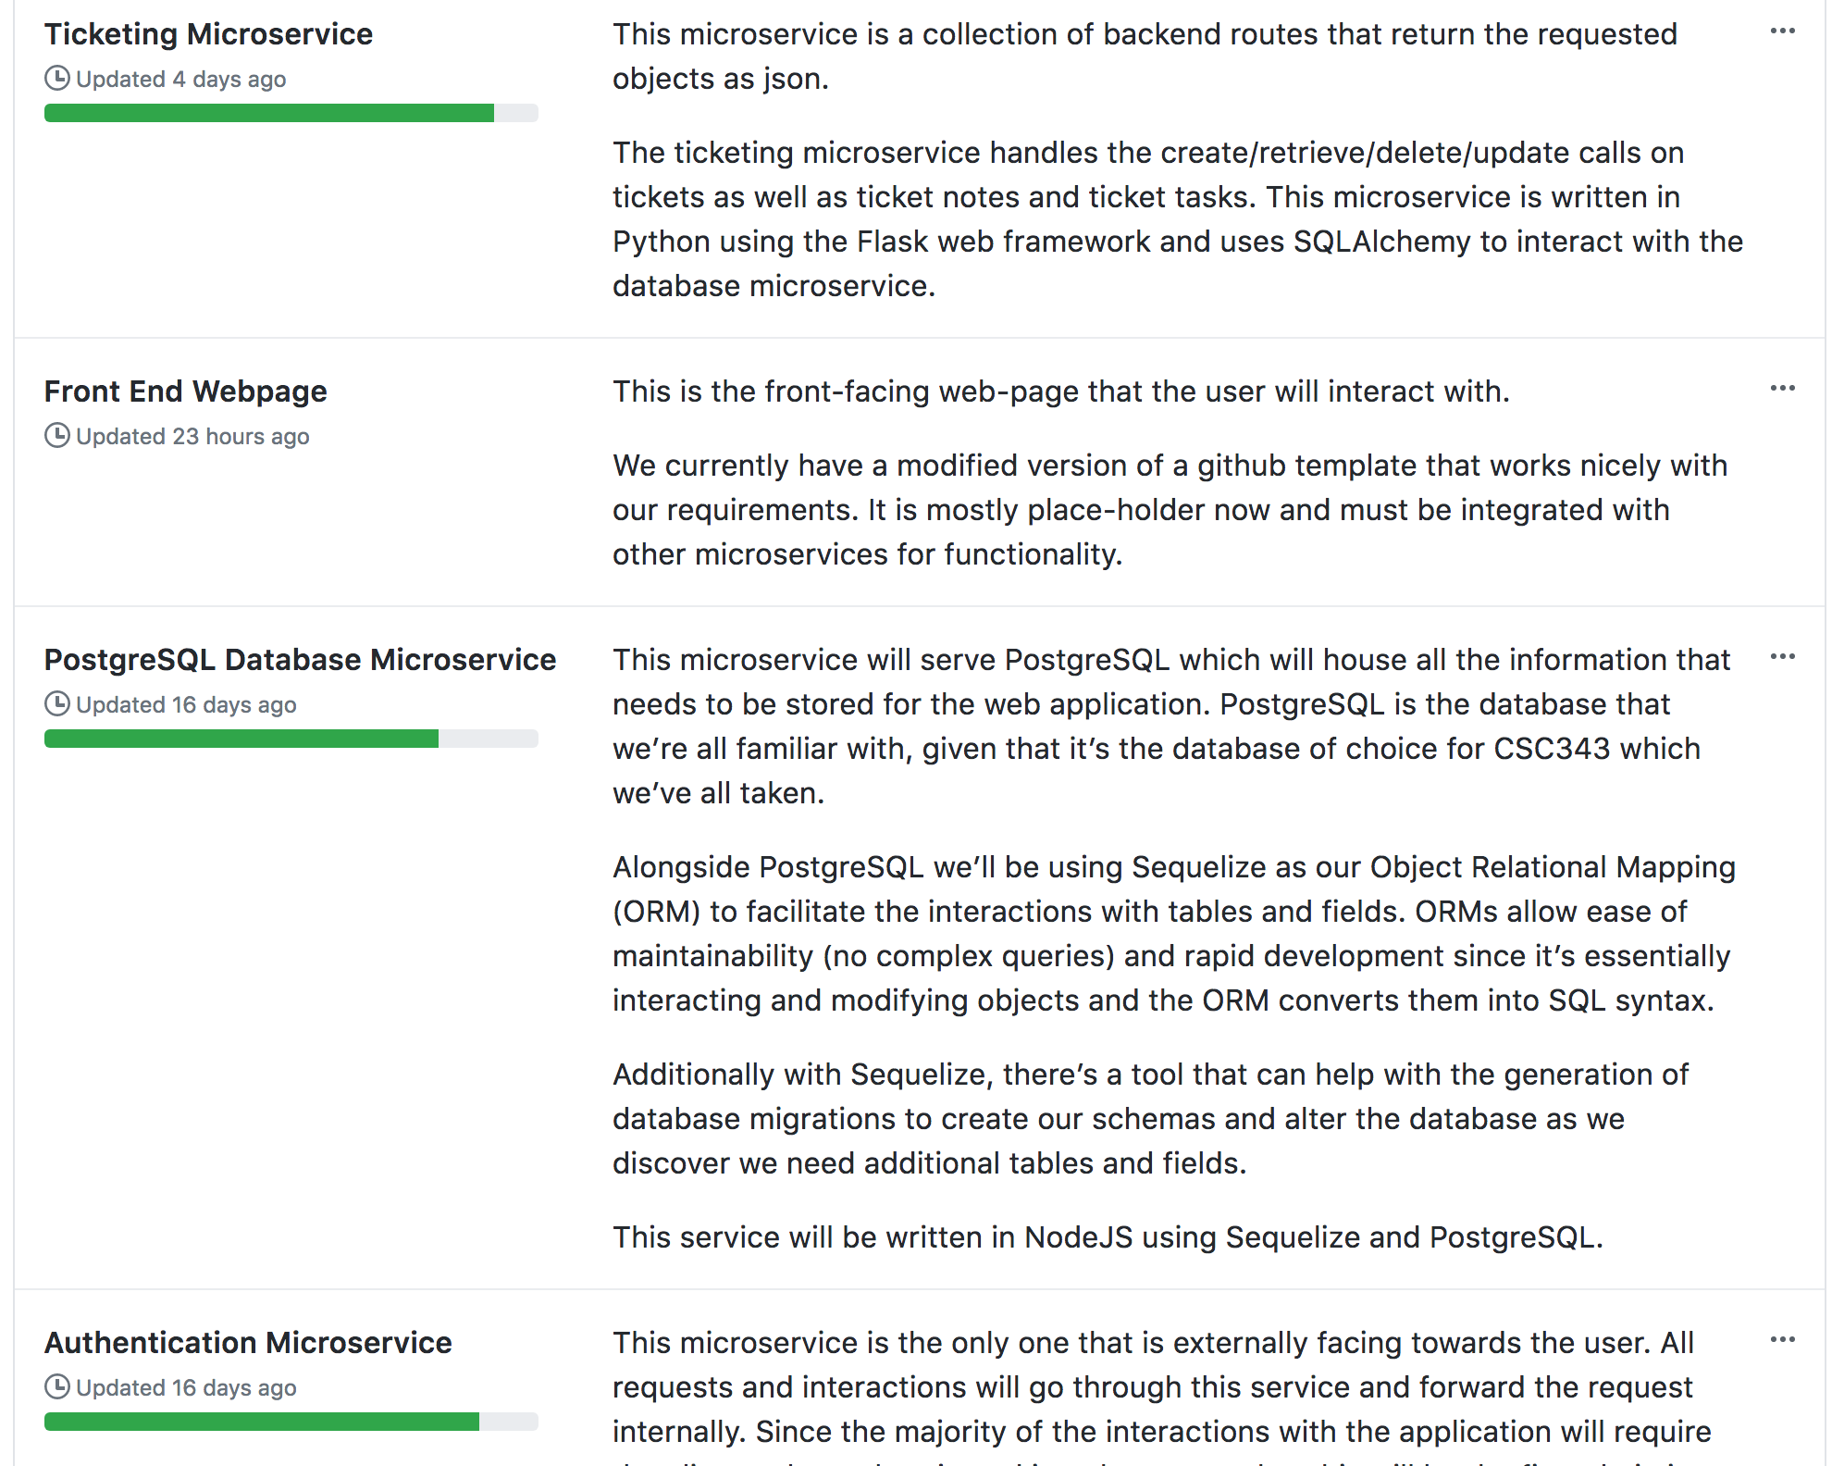
Buddy System Epilogue

Slide 25
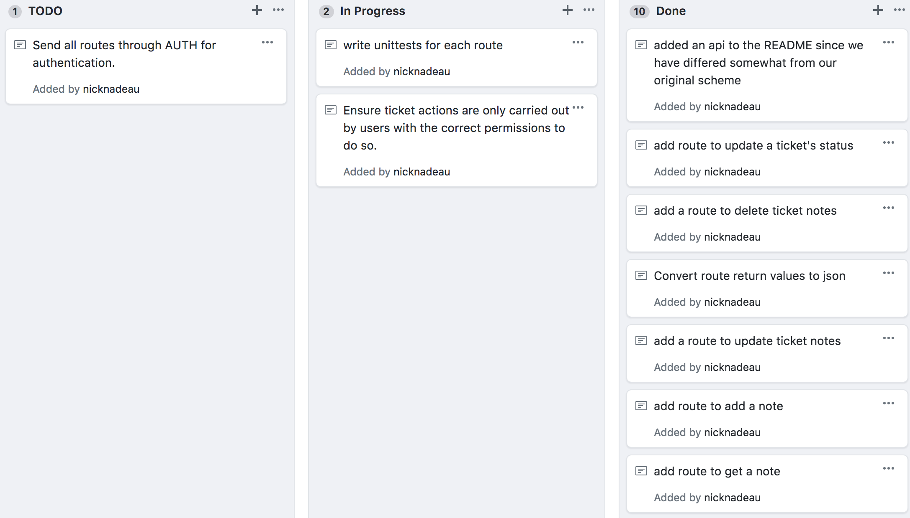

Slide 26
Code Reviews & Pull Requests
Peer review

Slide 27
Code Reviews & Pull Requests
Peer review
Ensure seamless integration

Slide 28
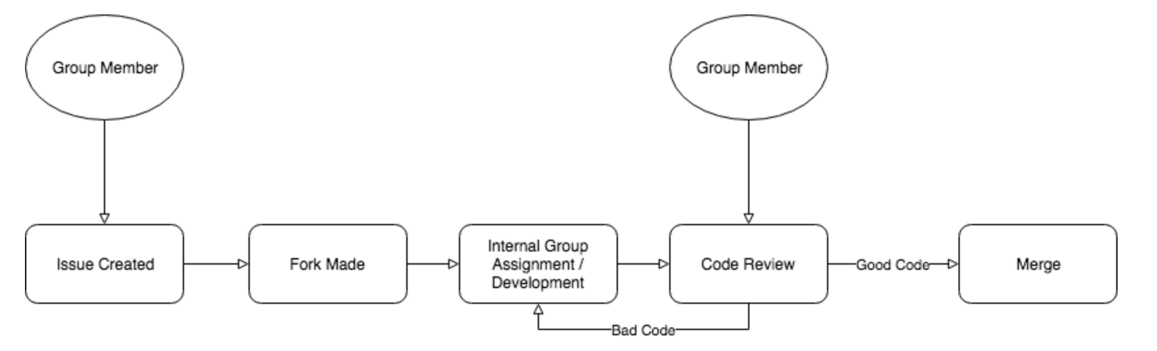
Code Reviews & Pull Requests
Peer review
Ensure seamless integration

Slide 29
Code Reviews & Pull Requests
1:1 Ratio Pull Request and Issues

Slide 30
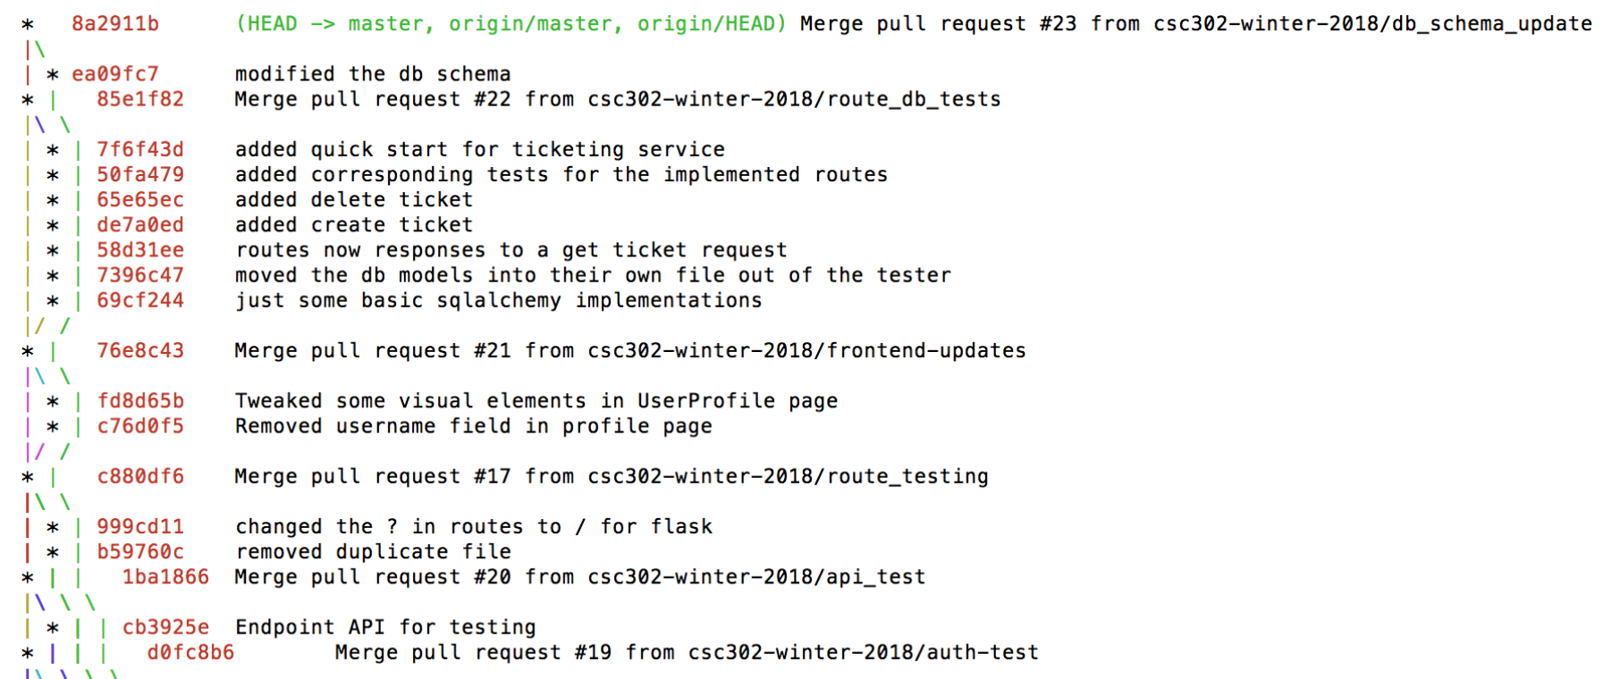
Code Reviews & Pull Requests
1:1 Ratio Pull Request and Issues

Slide 31
Milestones
Create a set of well defined goals

Slide 32
Milestones
Create a set of well defined goals
A measure of our progress

Slide 33
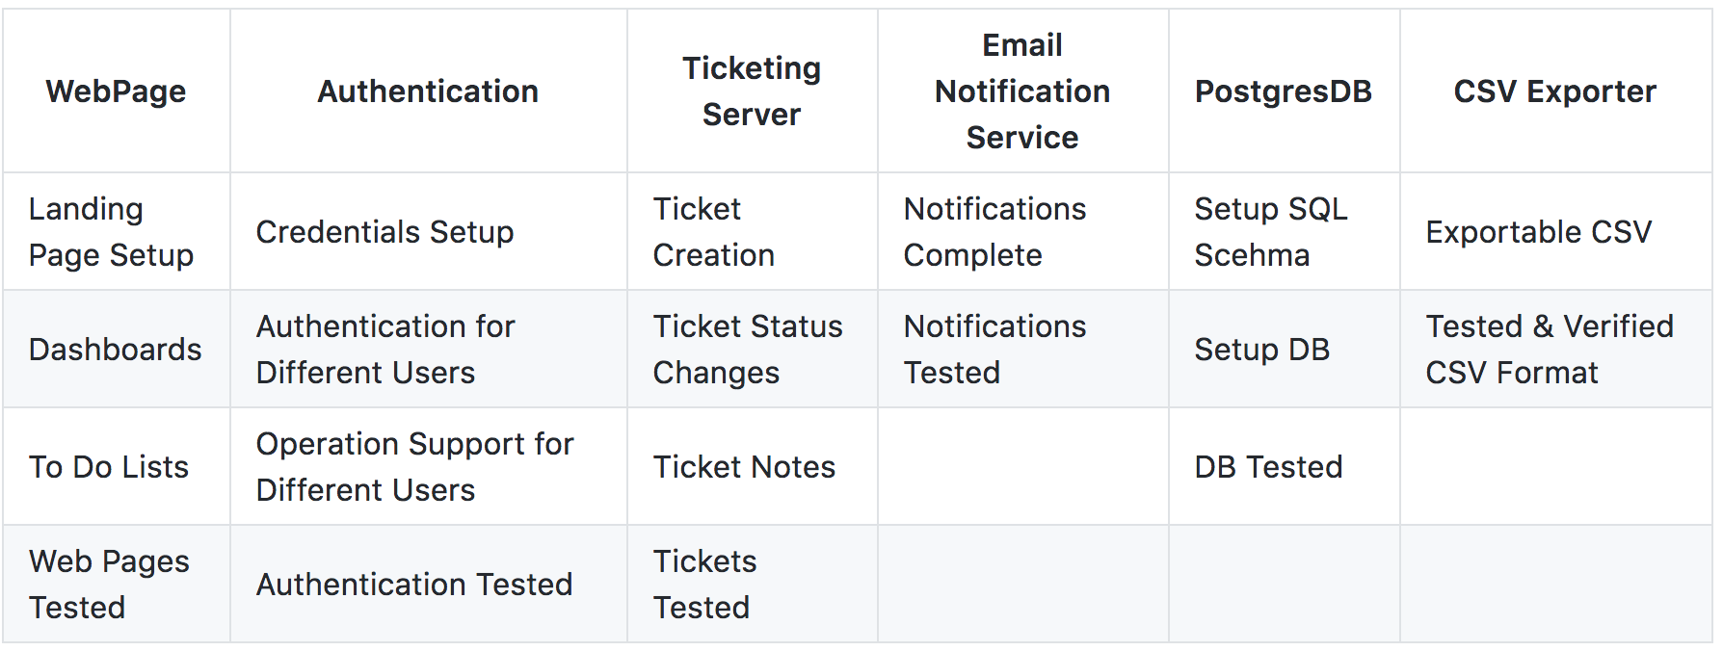
Milestones
Create a set of well defined goals
A measure of our progress

Slide 34
Github & Discord
Discord Like Slack But Better

Slide 35
Github & Discord
Discord Like Slack But Better
Integrated with Github

Slide 36
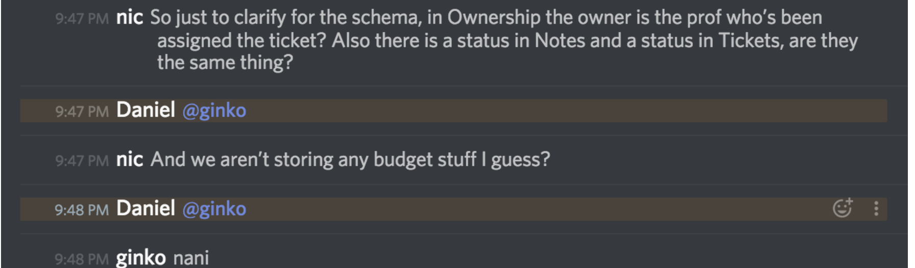
Github & Discord

Slide 37
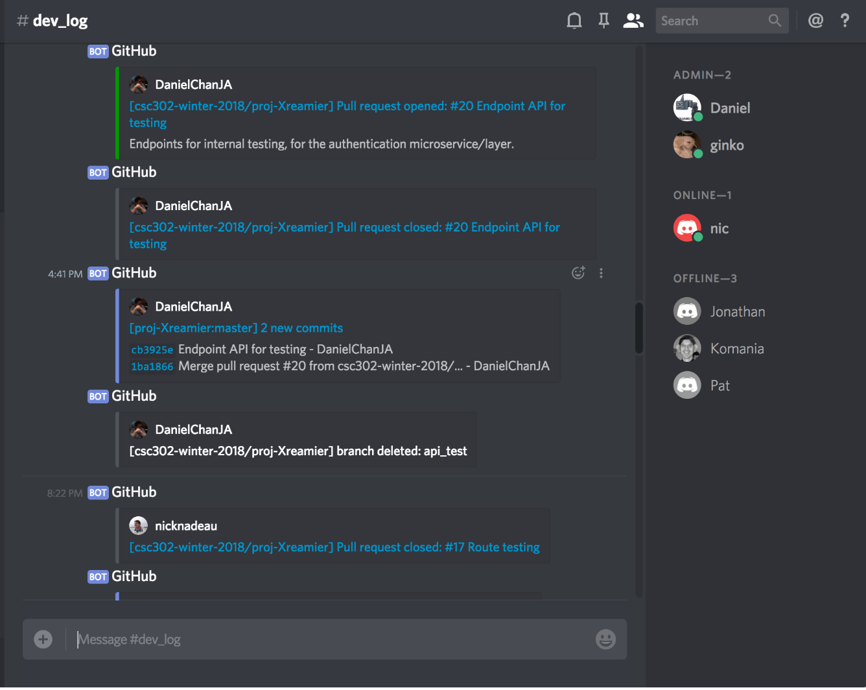
Github & Discord

Slide 38
Demo

Slide 39
Testing
Travis CI
Linting
Unit Tests (Regression Testing)
Mocha and Chai
Mocking API Calls

Slide 40
Testing
Travis CI
Linting
Unit Tests (Regression Testing)
Mocha and Chai
Mocking API Calls
All automated

Slide 41
Status
Backend is done

Slide 42
Status
Backend is done
Frontend is done

Slide 43
Status
Backend is done
Frontend is done
Unfortunately they aren’t linked

Slide 44
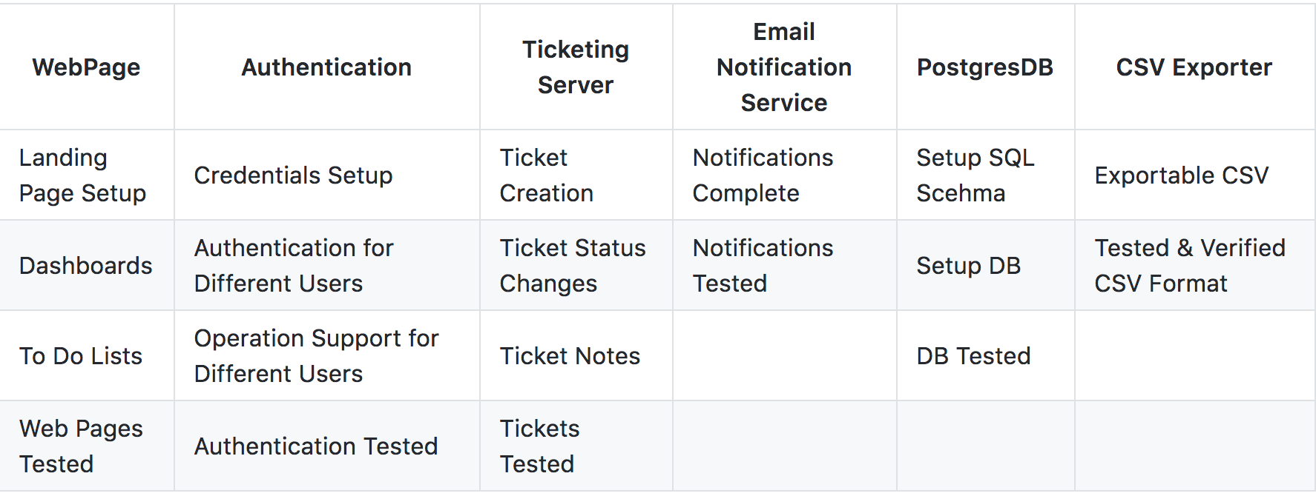
Status

Slide 45
Status

Slide 46
Status

Slide 47
Status

Slide 48
Status

Slide 49
Status

Slide 50
Status

Slide 51
Next Steps
Connect front and back end
More testing (can never have enough!)
CSV exporter
Deployment

Slide 52
What we would have done differently
Stricter sprints, with better enforced deadlines
Implement testing from the very beginning
More training sessions on how to use new technologies and git

